Slide 1

Multi-Branch Enterprise Network Implementation Using
Cisco Packet Tracer

Slide 2

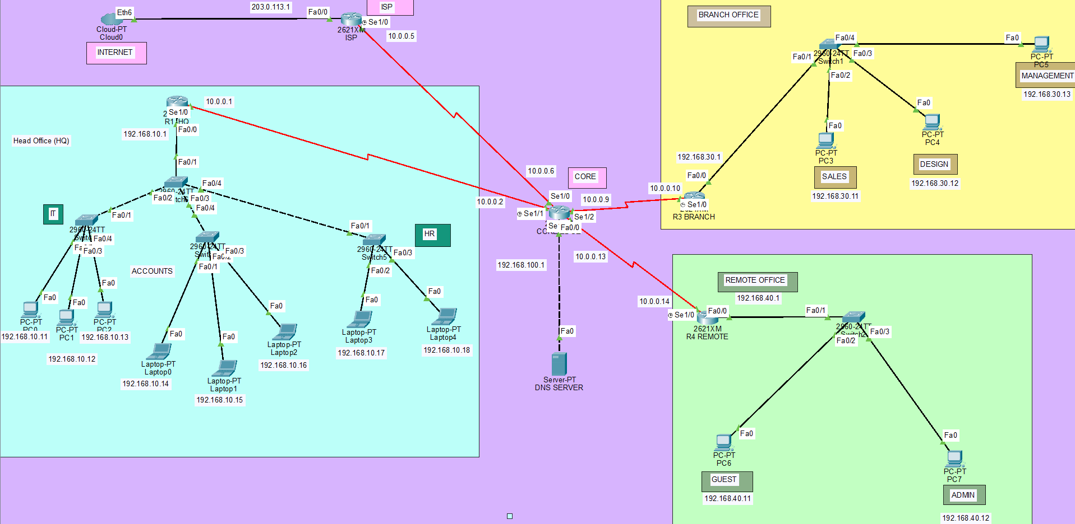
How This Project Supports Industries
This project demonstrates how industries can connect multiple offices and manage communication through a centralized network.
Centralized Communication: Connects the head office, branch offices, and remote offices for smooth data sharing.
Automatic IP Allocation: DHCP reduces manual configuration and saves time when connecting new devices.
Domain Name Resolution: DNS allows employees to access network resources using names instead of remembering IP addresses.
Reliable Connectivity: OSPF and RIP demonstrate dynamic routing to exchange network information between routers.
External Network Connectivity: NAT allows multiple internal devices to share a public-facing IP address.
Secure Remote Access: SSH provides encrypted remote management of network devices.
Scalability: The network design can be extended to support additional offices, users, and devices.
Industry Applications:
IT companies
Banking and financial institutions
Educational organizations
Healthcare networks
Multinational companies with multiple offices

Slide 3
Lets Begin With the Configuration

Slide 4
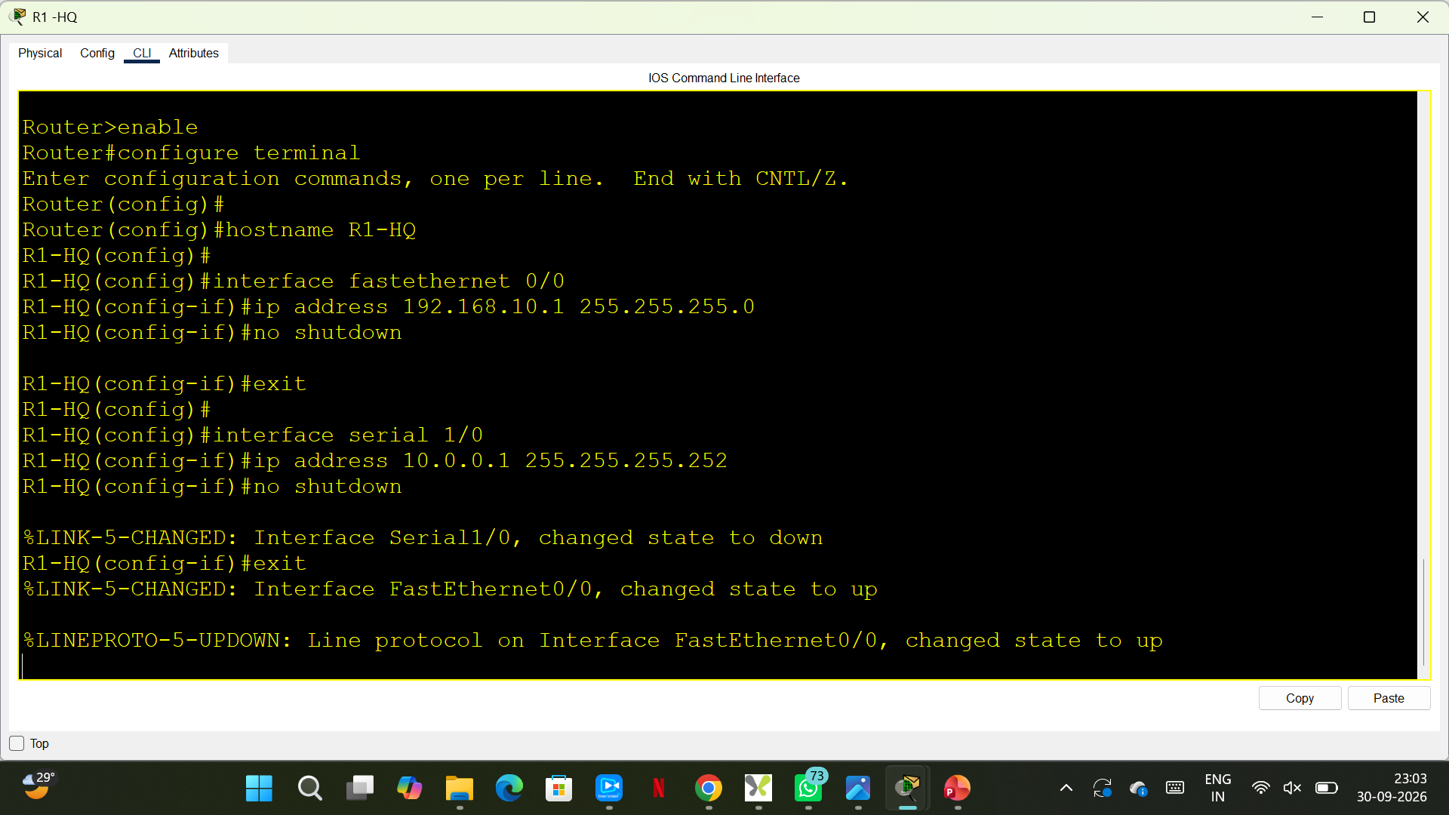
Configure R1 HQ

Slide 5
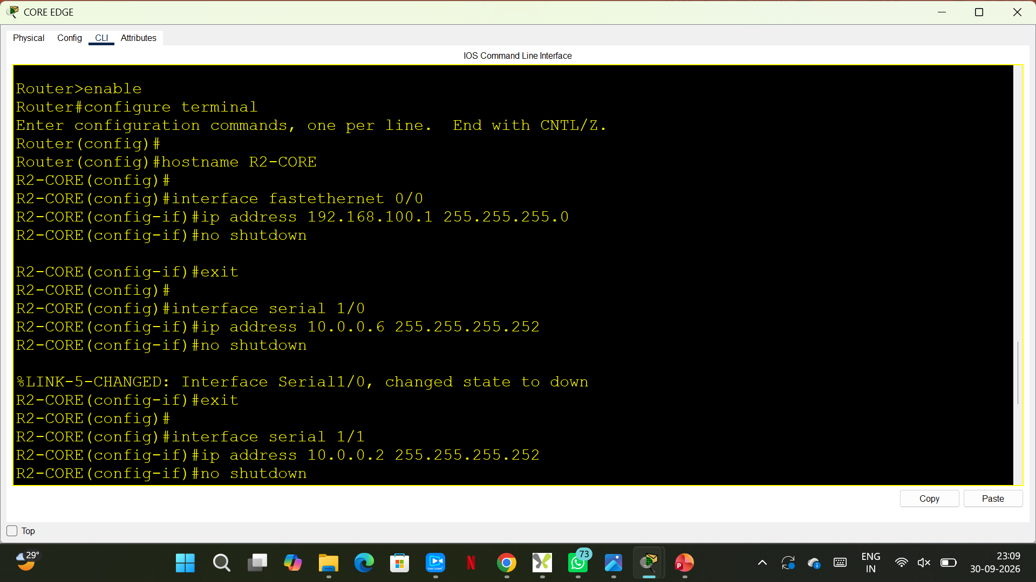
Configure R2 CORE

Slide 6
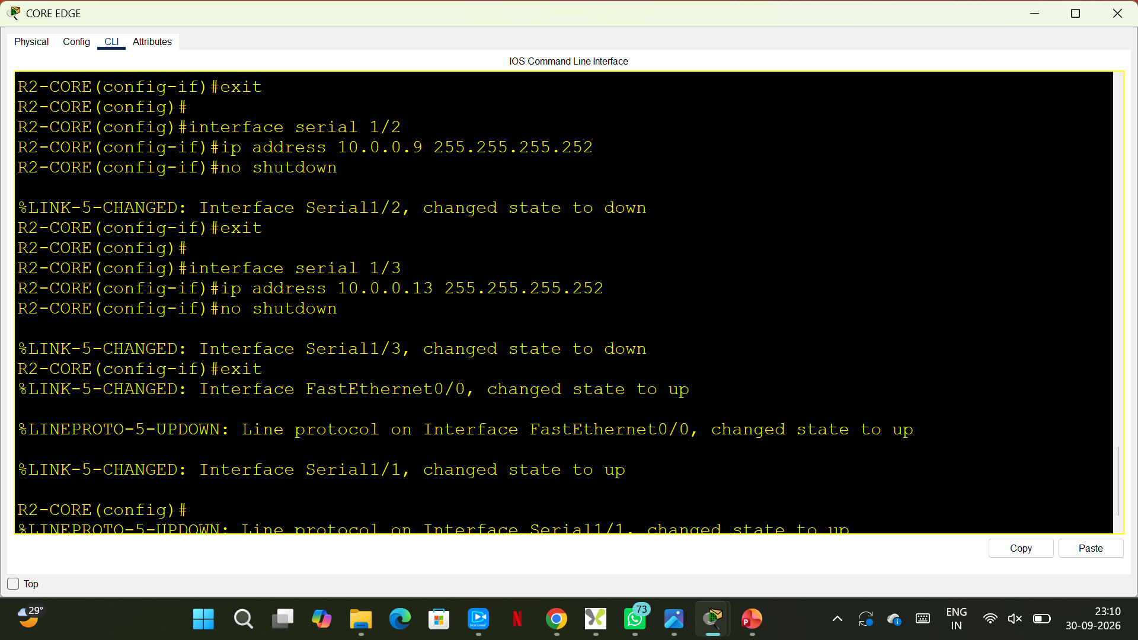
Configure R2 CORE DCE interface serial 1/1 --- clock rate 64000

Slide 7
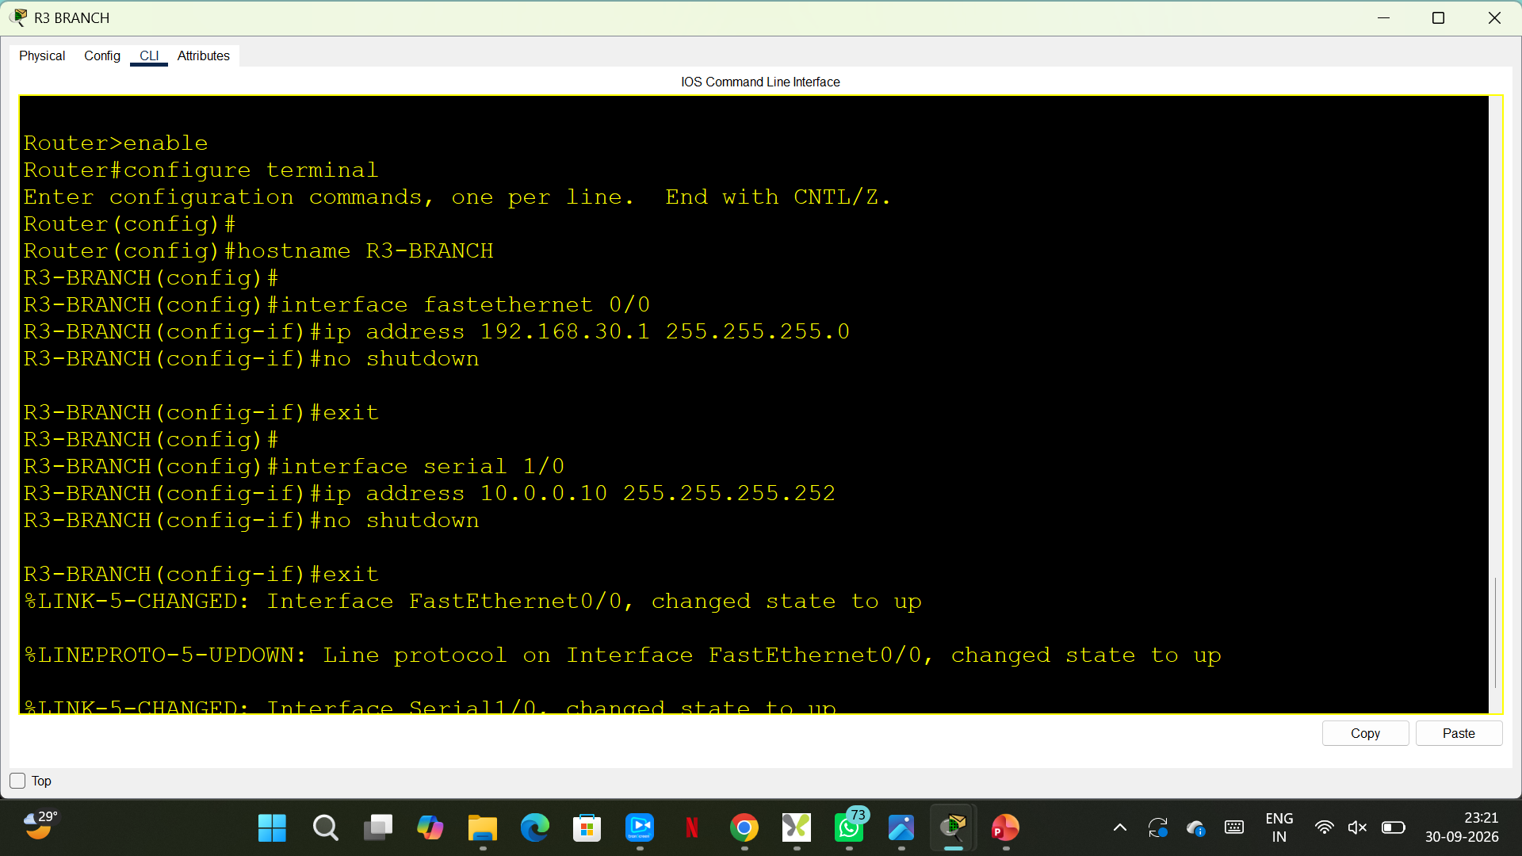
Configure R3 BRANCH DCE interface serial 1/0 -- clock rate 64000

Slide 8
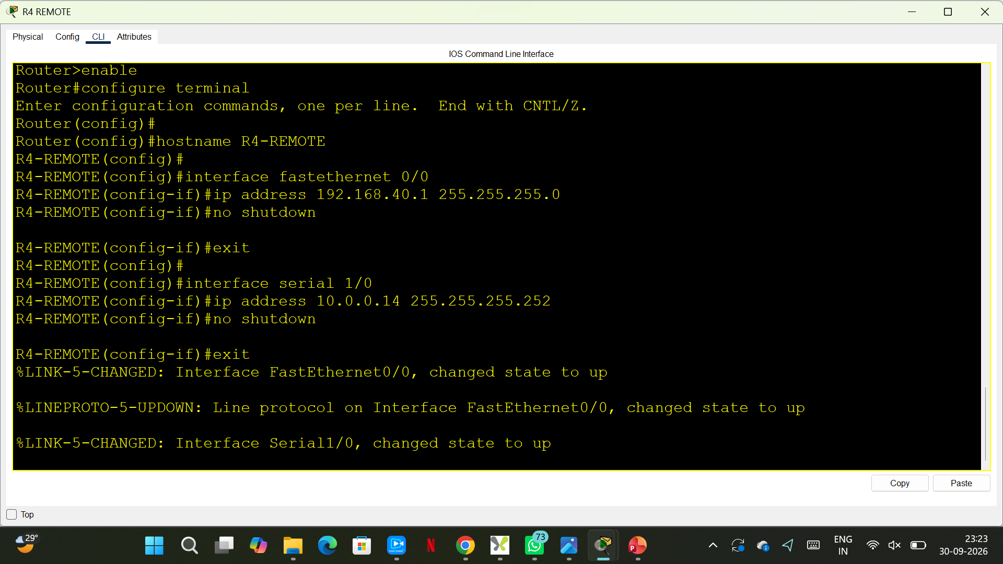
Configure R4 REMOTE DCE interface serial 1/0 -- clock rate 64000

Slide 9
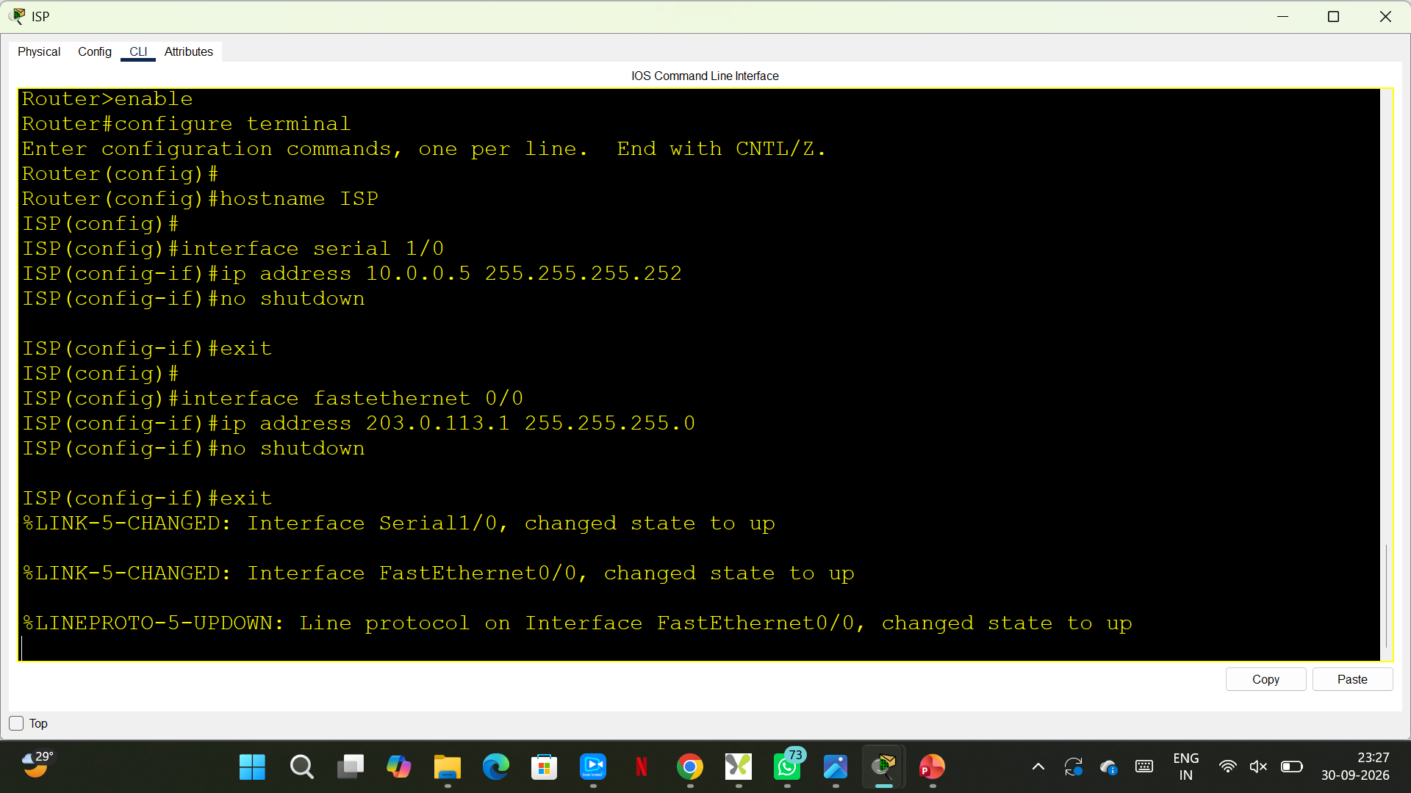
Configure ISP

Slide 10
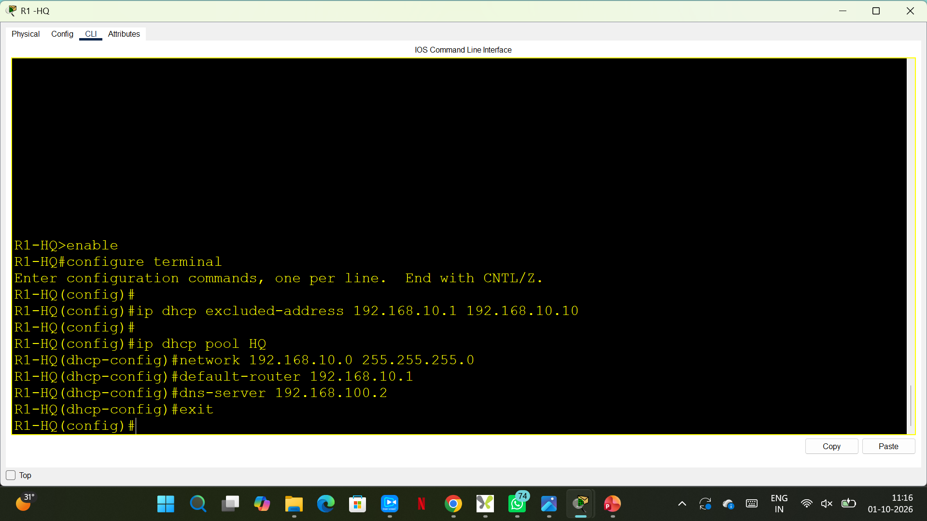
DHCP on R1 — HQ

Slide 11
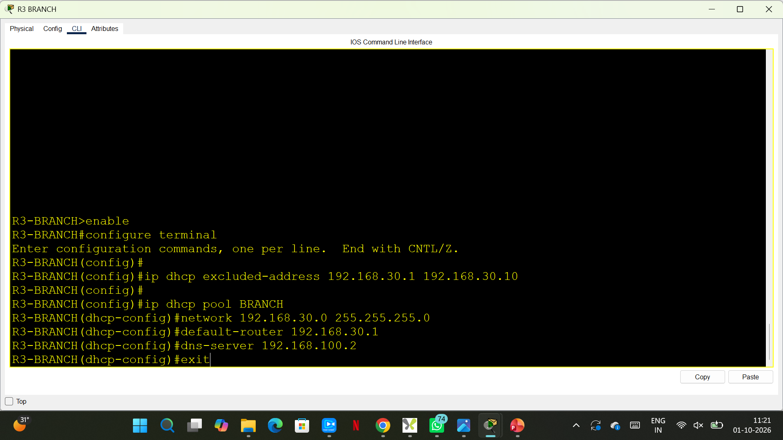
DHCP on R3 — Branch

Slide 12
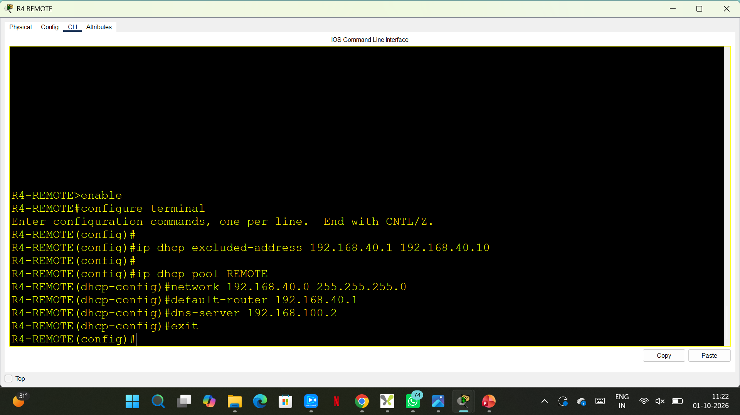
DHCP on R4 — Remote

Slide 13
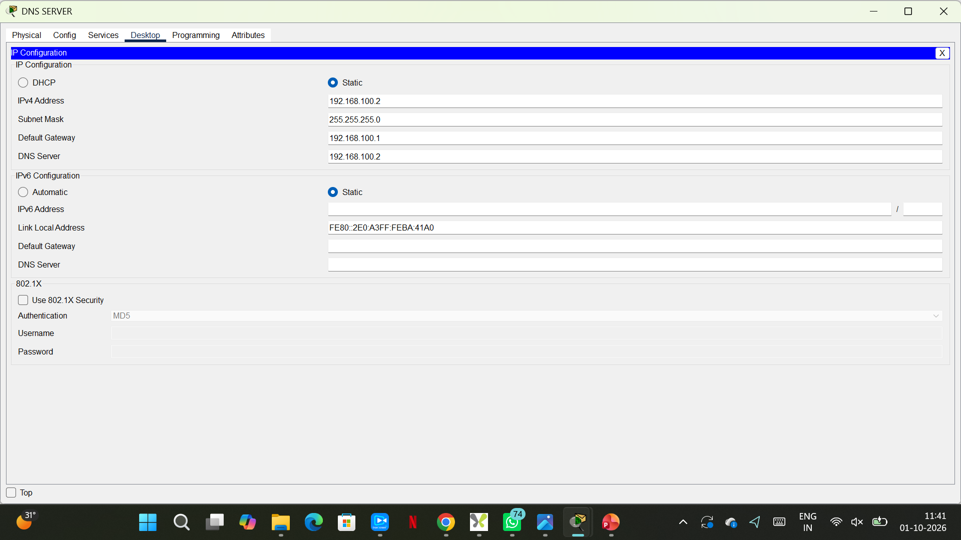
DNS SERVER – Ip configuration

Slide 14
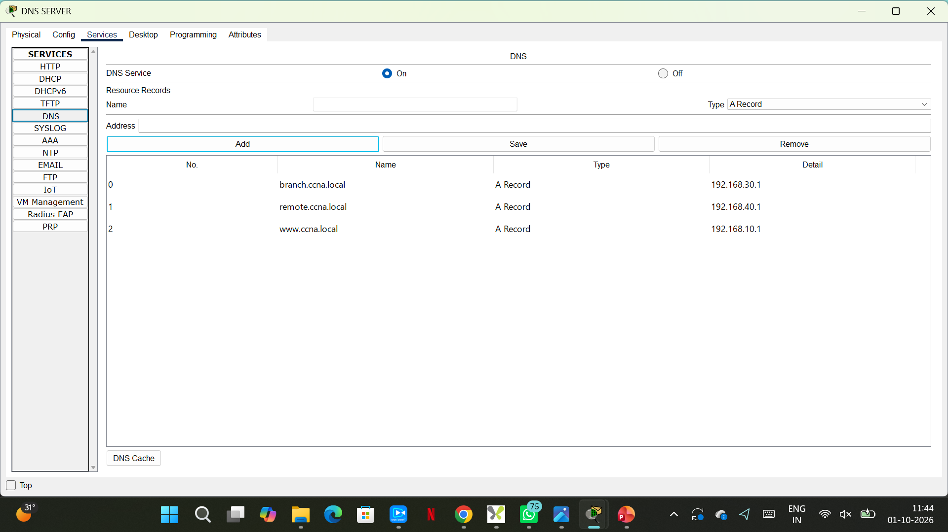
DNS SERVER - SERVICES

Slide 15
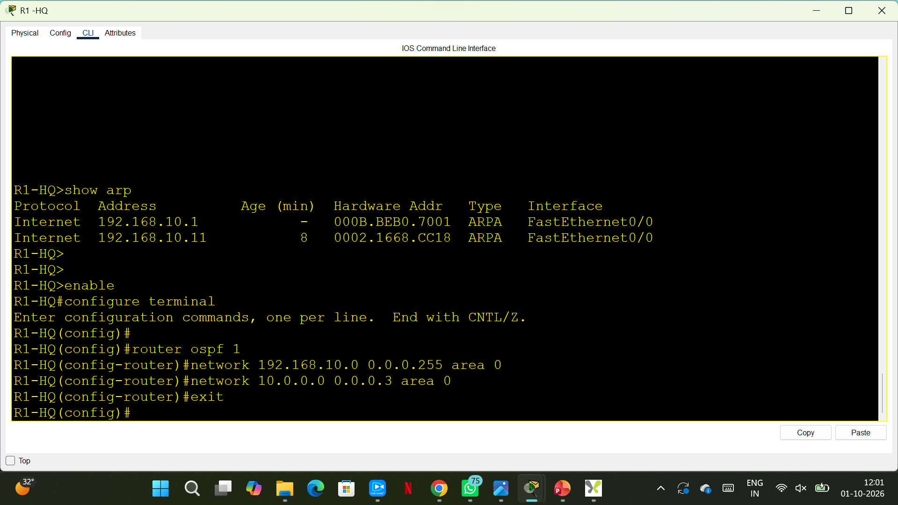
R1-HQ OSPF - We'll use OSPF area 0 for internal network.

Slide 16
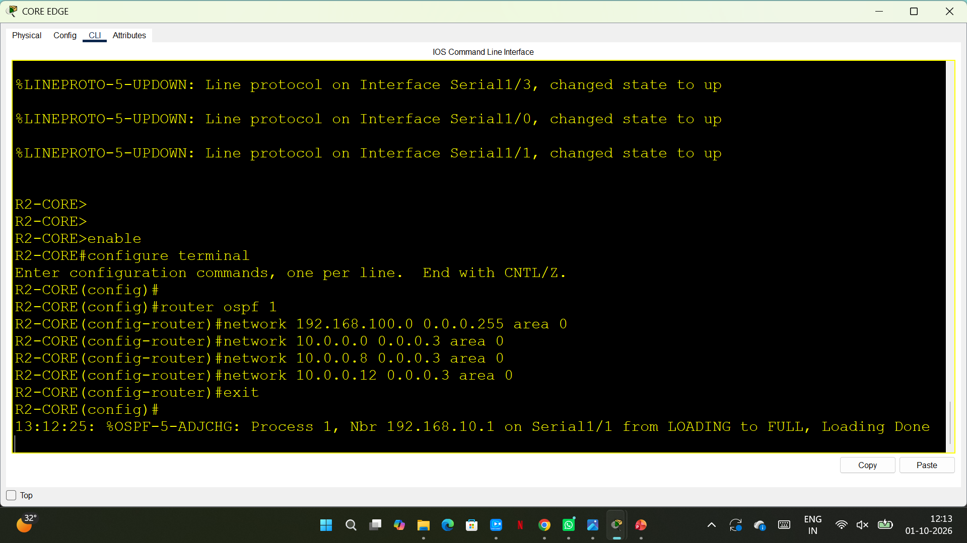
R2 CORE-
The important thing is: /30 subnets always increase in blocks of 4.
Why .9 and .10 use 10.0.0.8/30 For /30:
Network address = first IP
Usable IPs = next 2
IPsBroadcast = fourth IP
Easy way to remember /30
Just count by 4:
0 → 4 → 8 → 12 → 16 → 20 → 24 → ...
Each block looks like:
Network Host Host Broadcast
.0 .1 .2 .3
.4 .5 .6 .7
.8 .9 .10 .11
.12 .13 .14 .15
Notes:
The important thing is: /30 subnets always increase in blocks of 4.
Why .9 and .10 use 10.0.0.8/30 For /30:
Network address = first IP
Usable IPs = next 2
IPsBroadcast = fourth IP
Easy way to remember /30
Just count by 4:
0 → 4 → 8 → 12 → 16 → 20 → 24 → ...
Each block looks like:
Network Host Host Broadcast
.0 .1 .2 .3
.4 .5 .6 .7
.8 .9 .10 .11
.12 .13 .14 .15

Slide 17
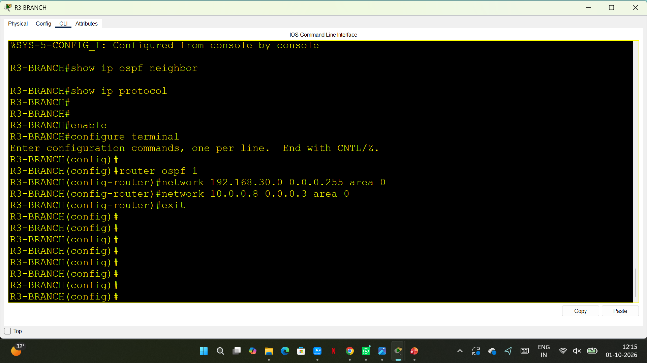
R3 BRANCH- We'll use OSPF area 0 for internal network.

Slide 18
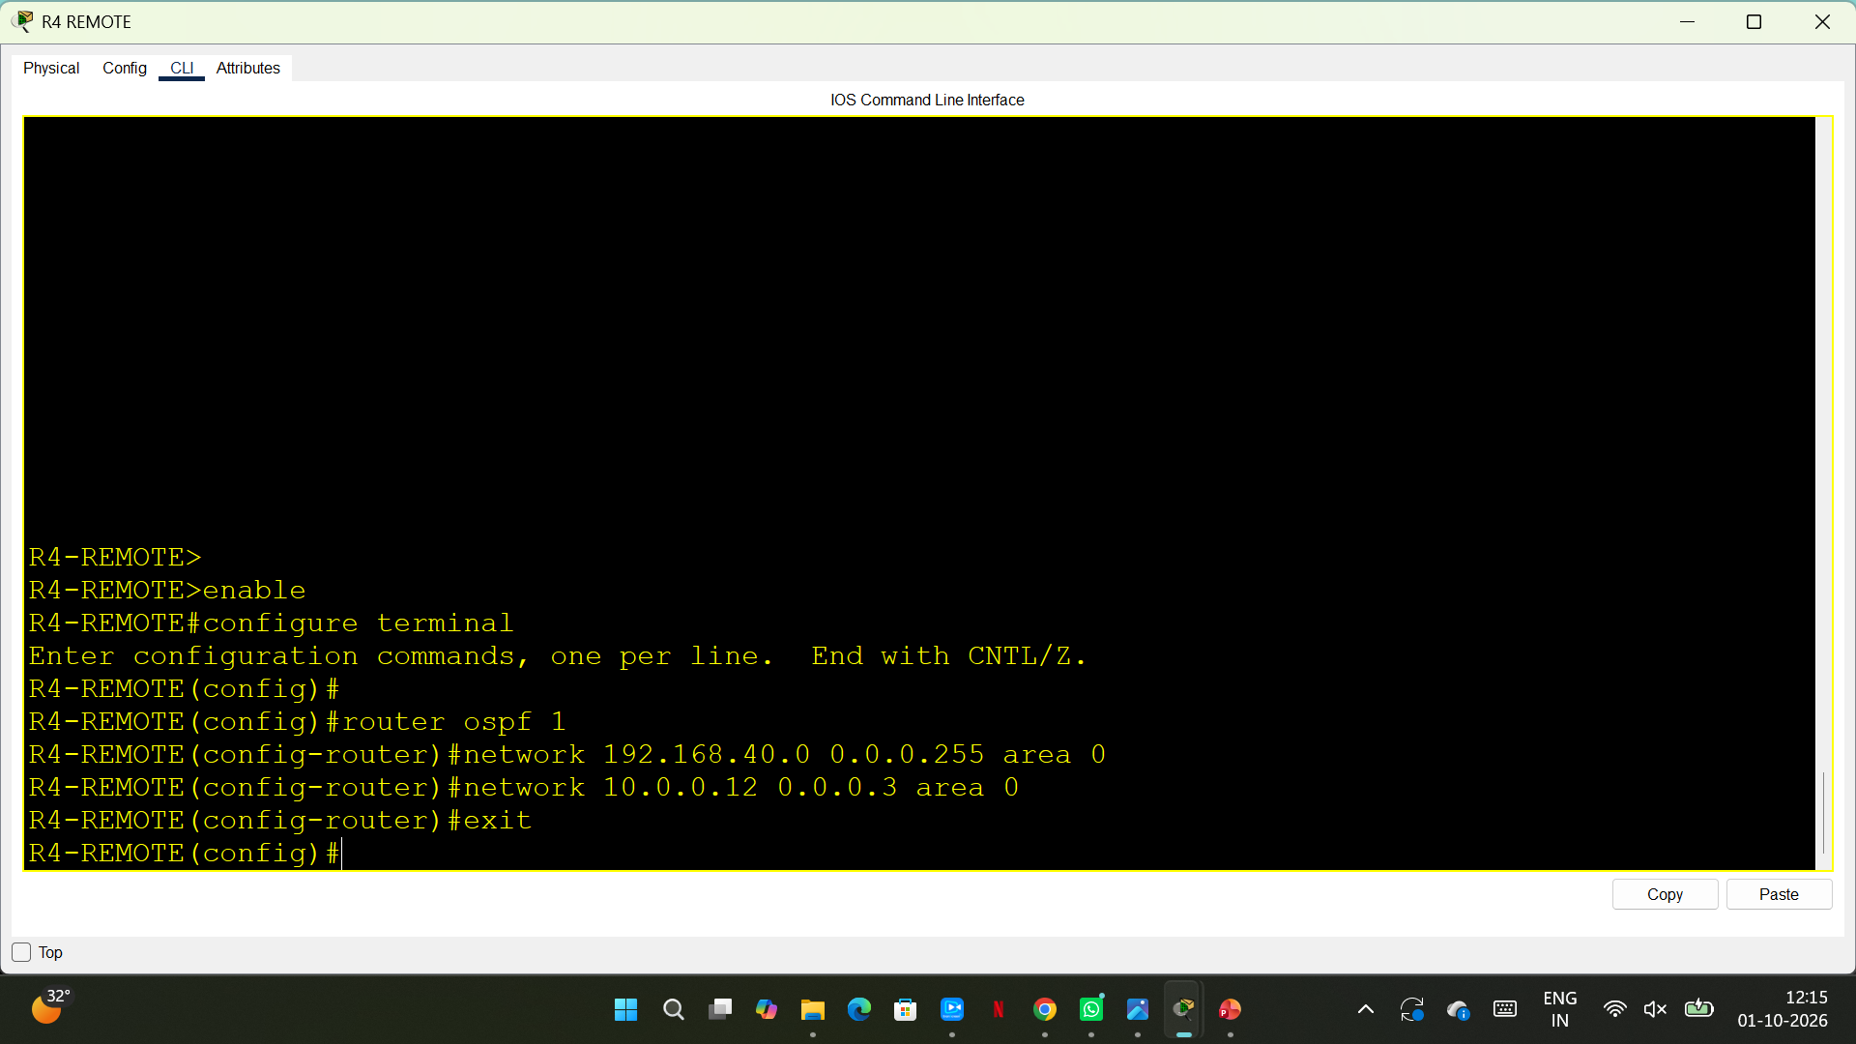
R4 REMOTE- We'll use OSPF area 0 for internal network.

Slide 19
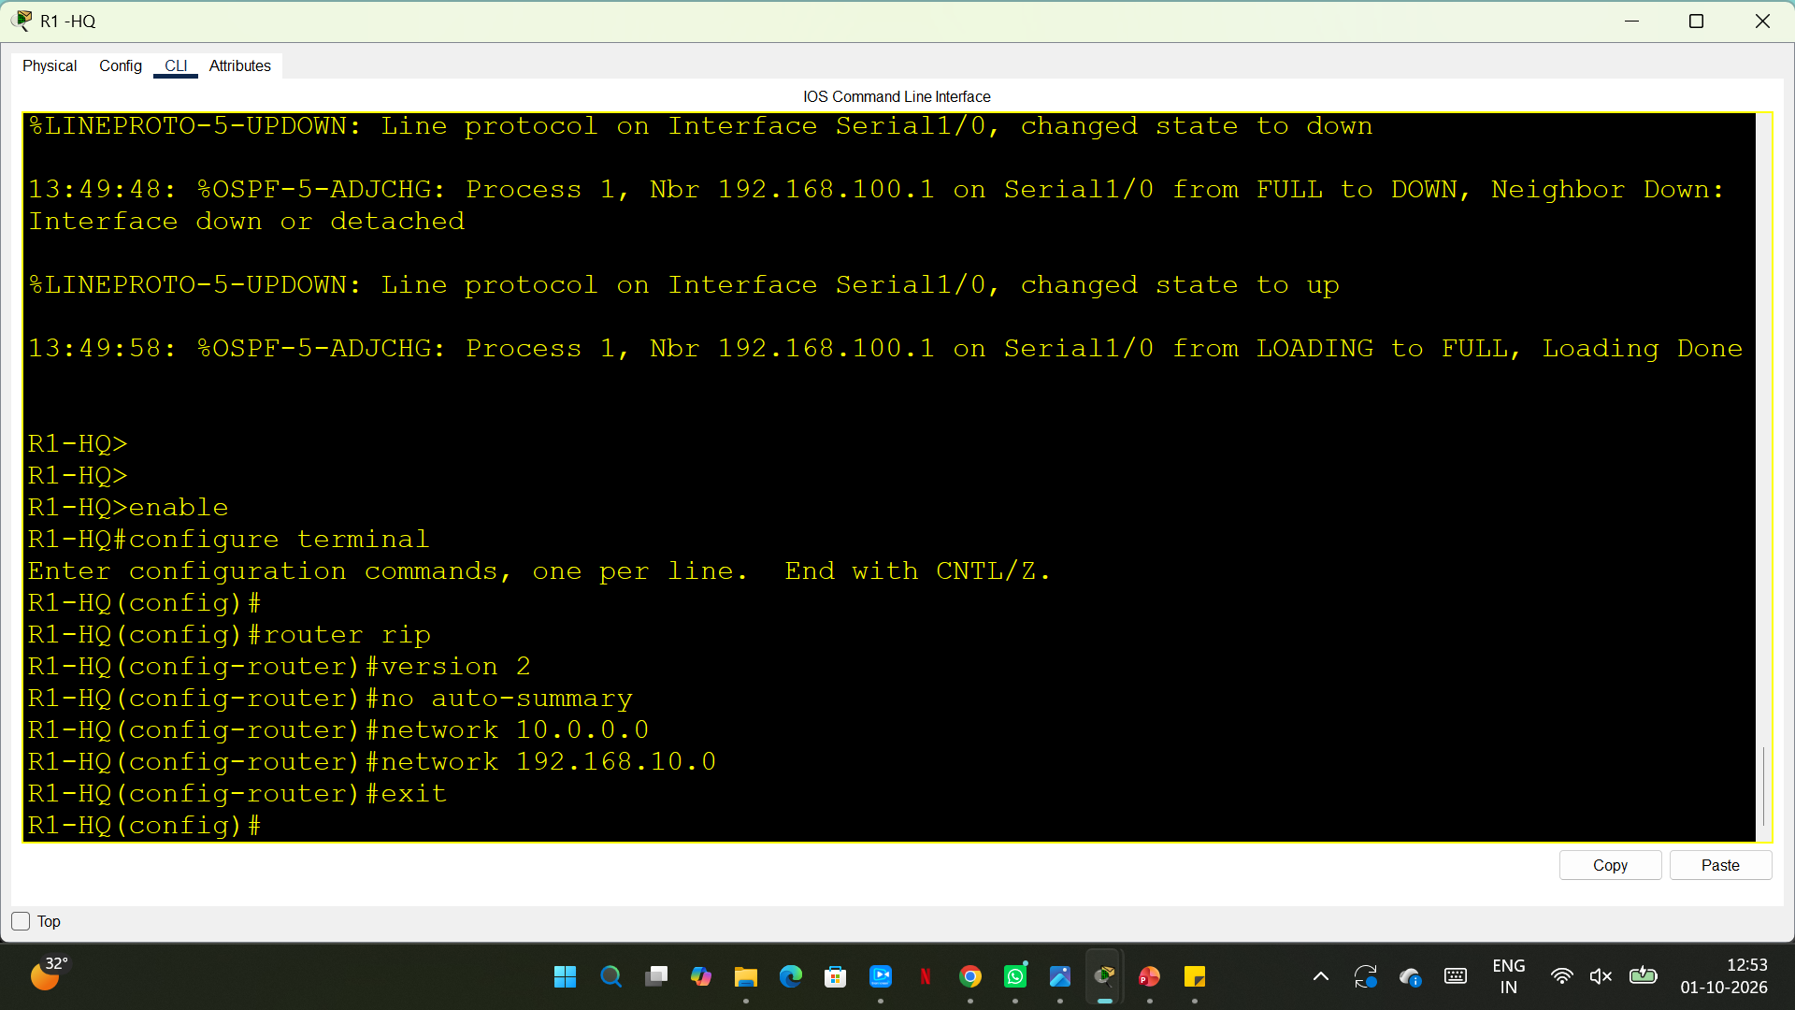
R1 HQ- RIP.

Slide 20
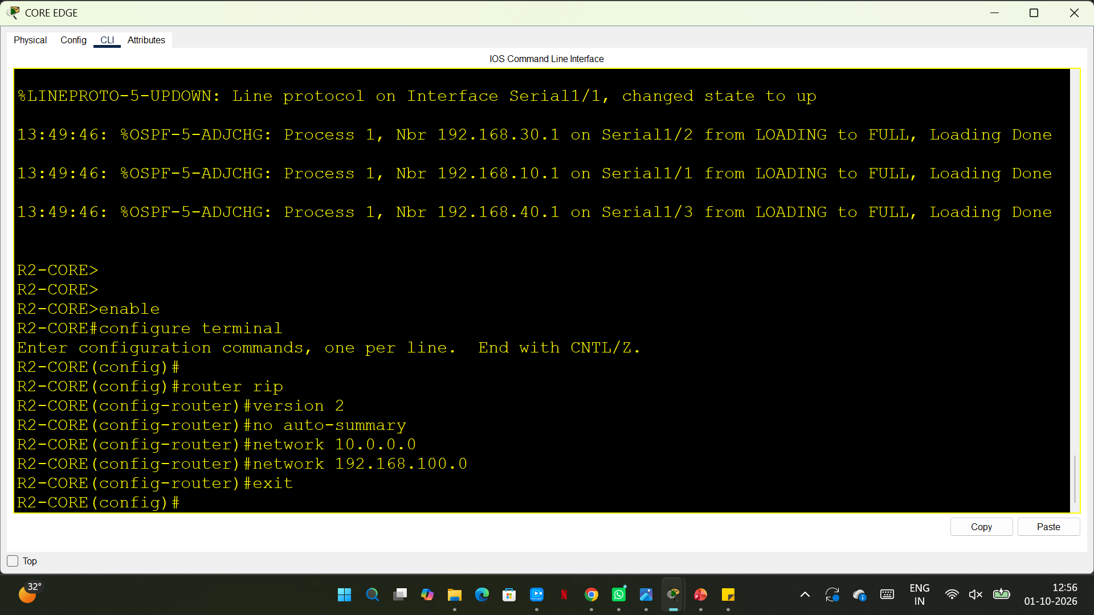
R2 CORE- RIP.

Slide 21
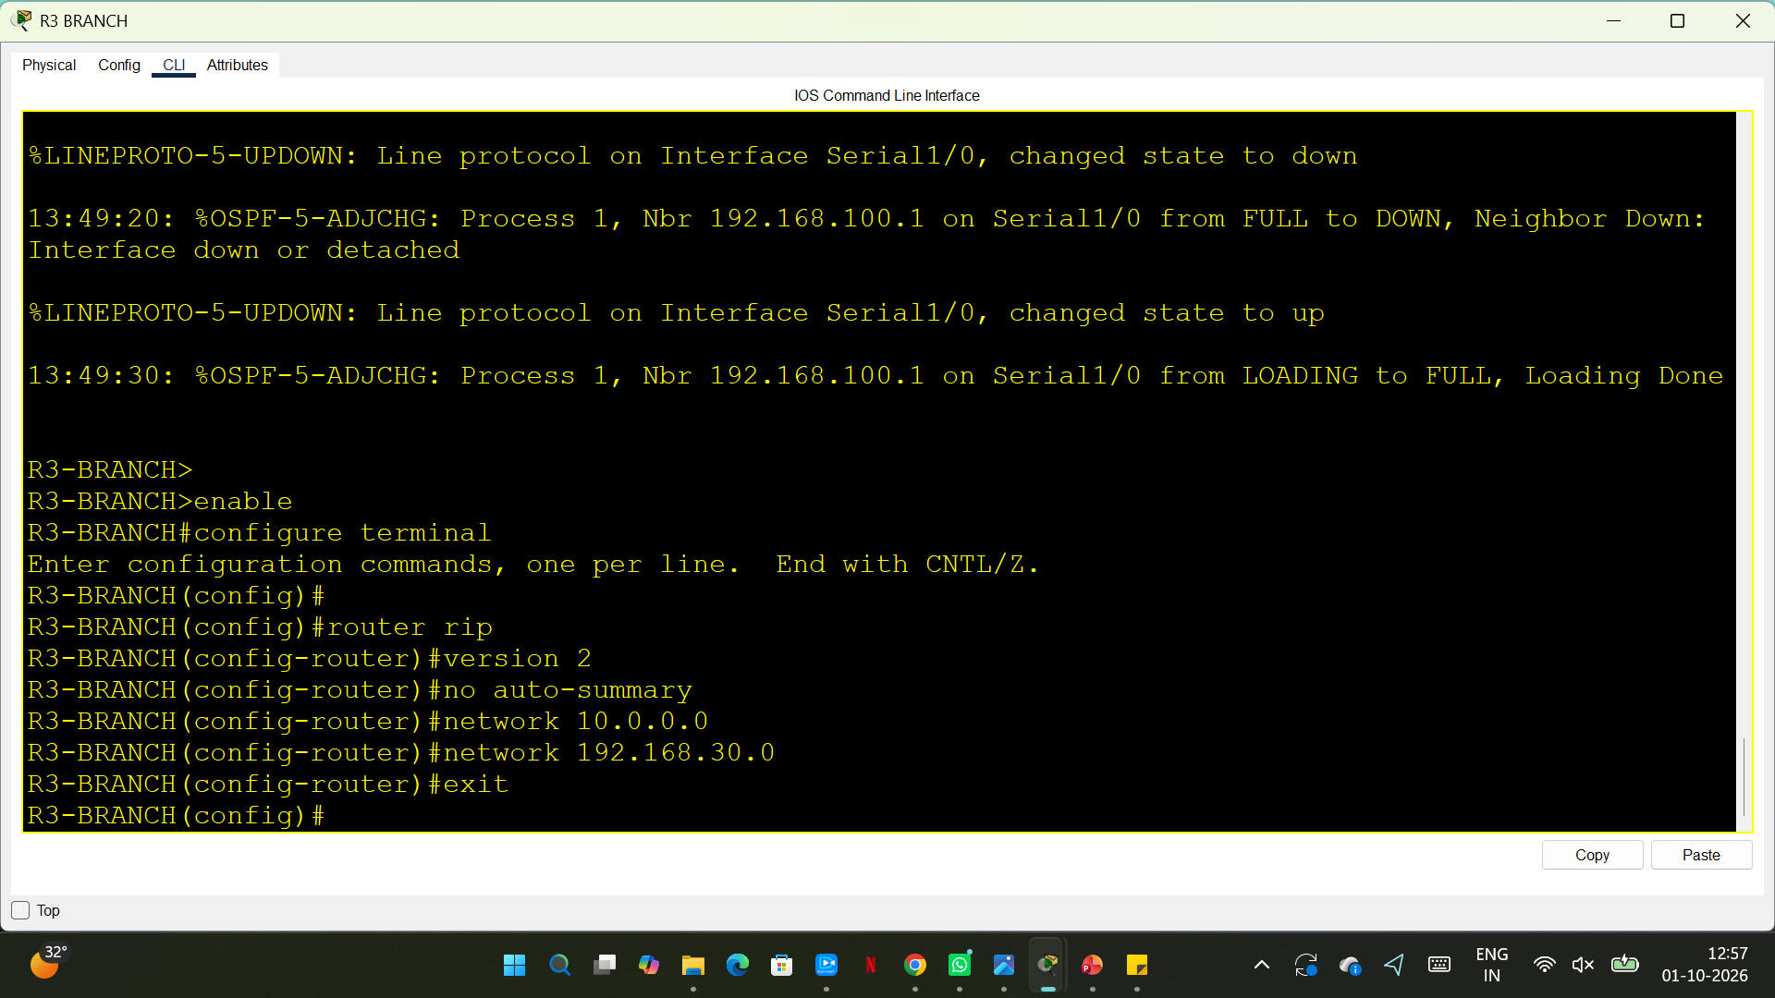
R3 BRANCH - RIP.

Slide 22
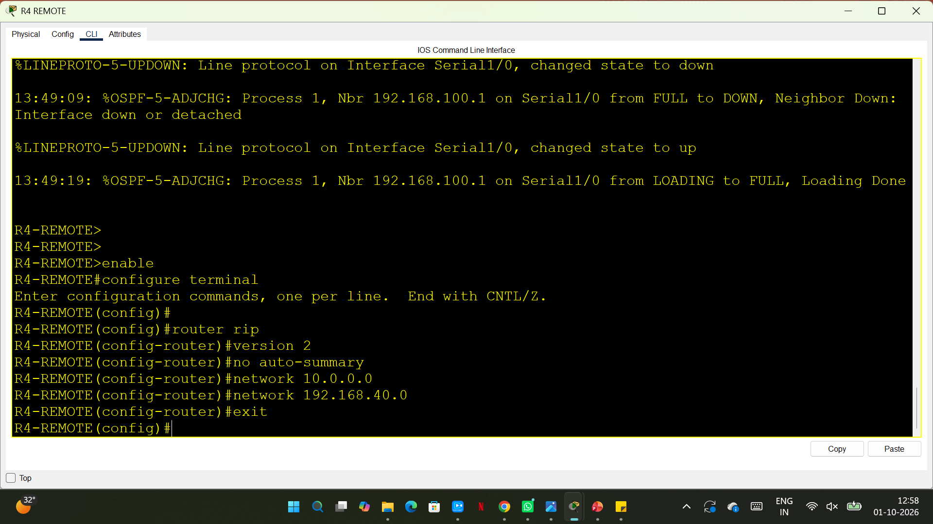
R4 REMOTE - RIP.

Slide 23
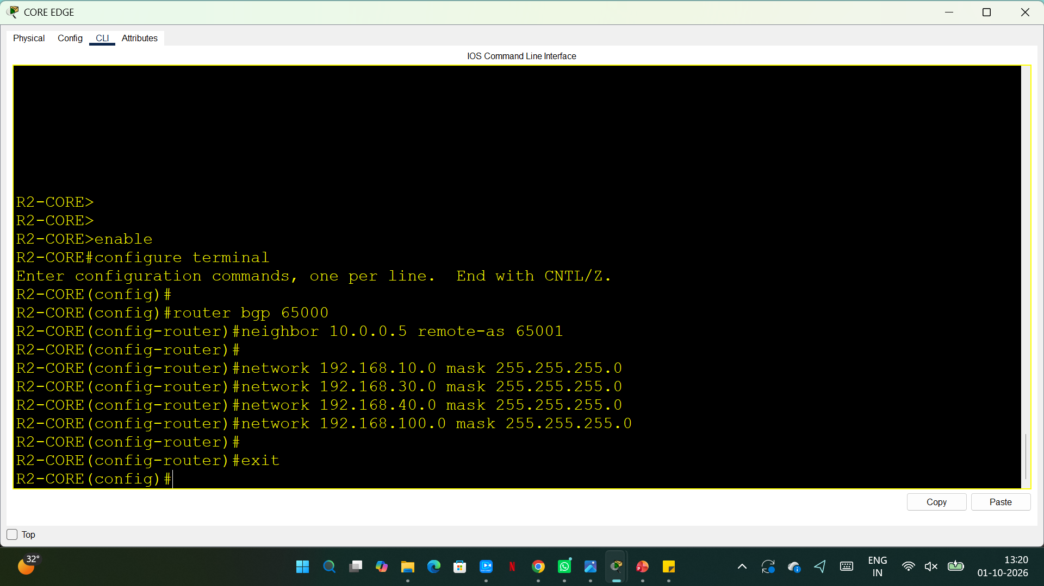
BGP between R2 CORE and ISP.

Slide 24
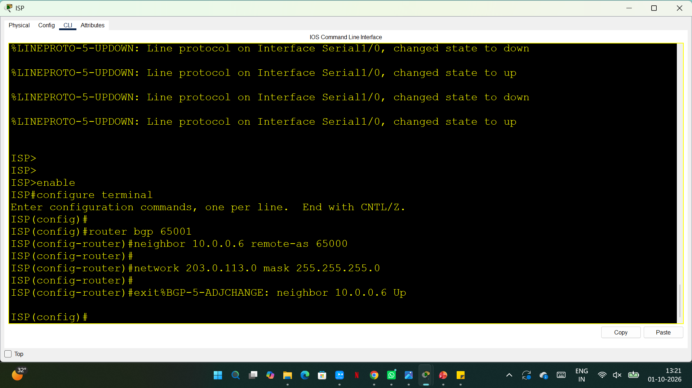
BGP between R2 CORE and ISP.

Slide 25
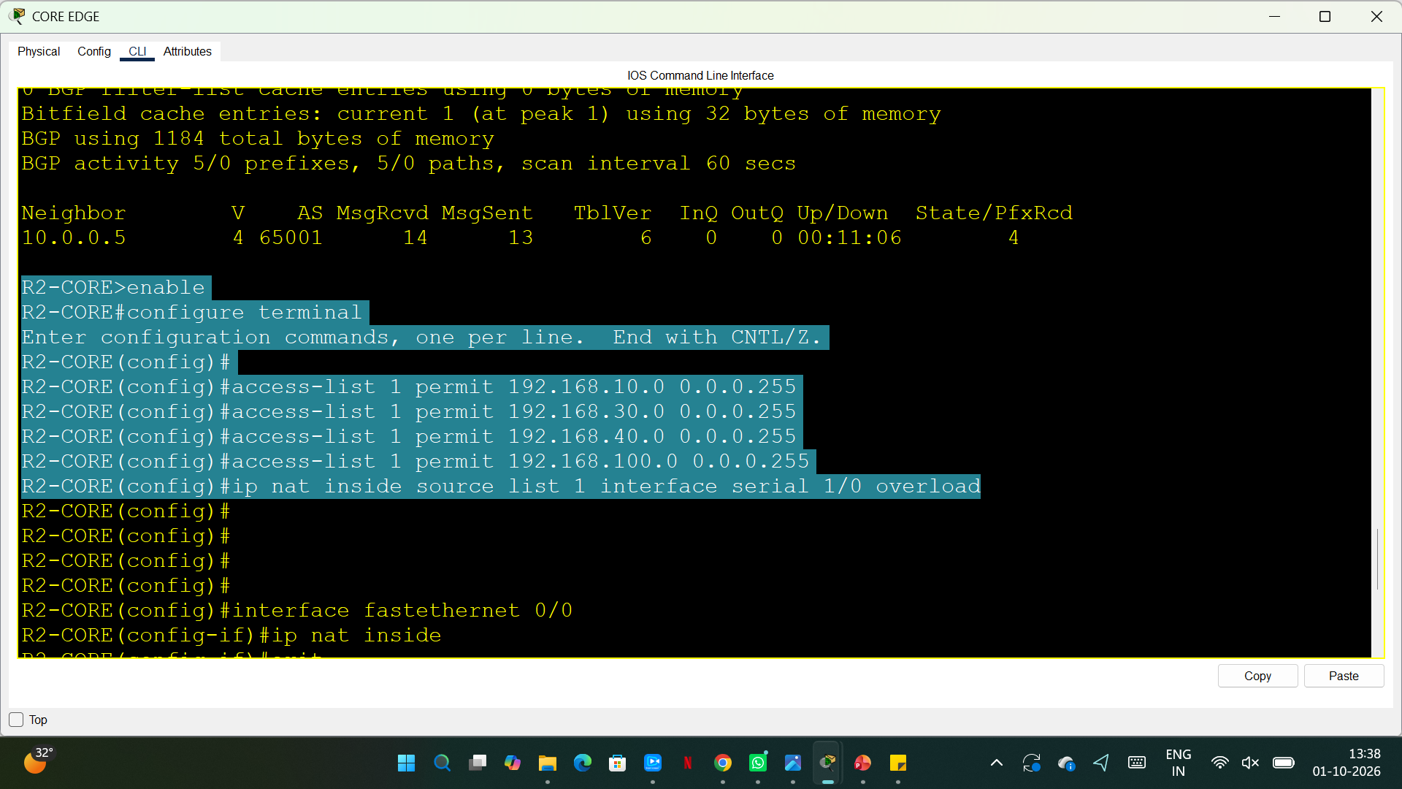
configure NAT

Slide 26
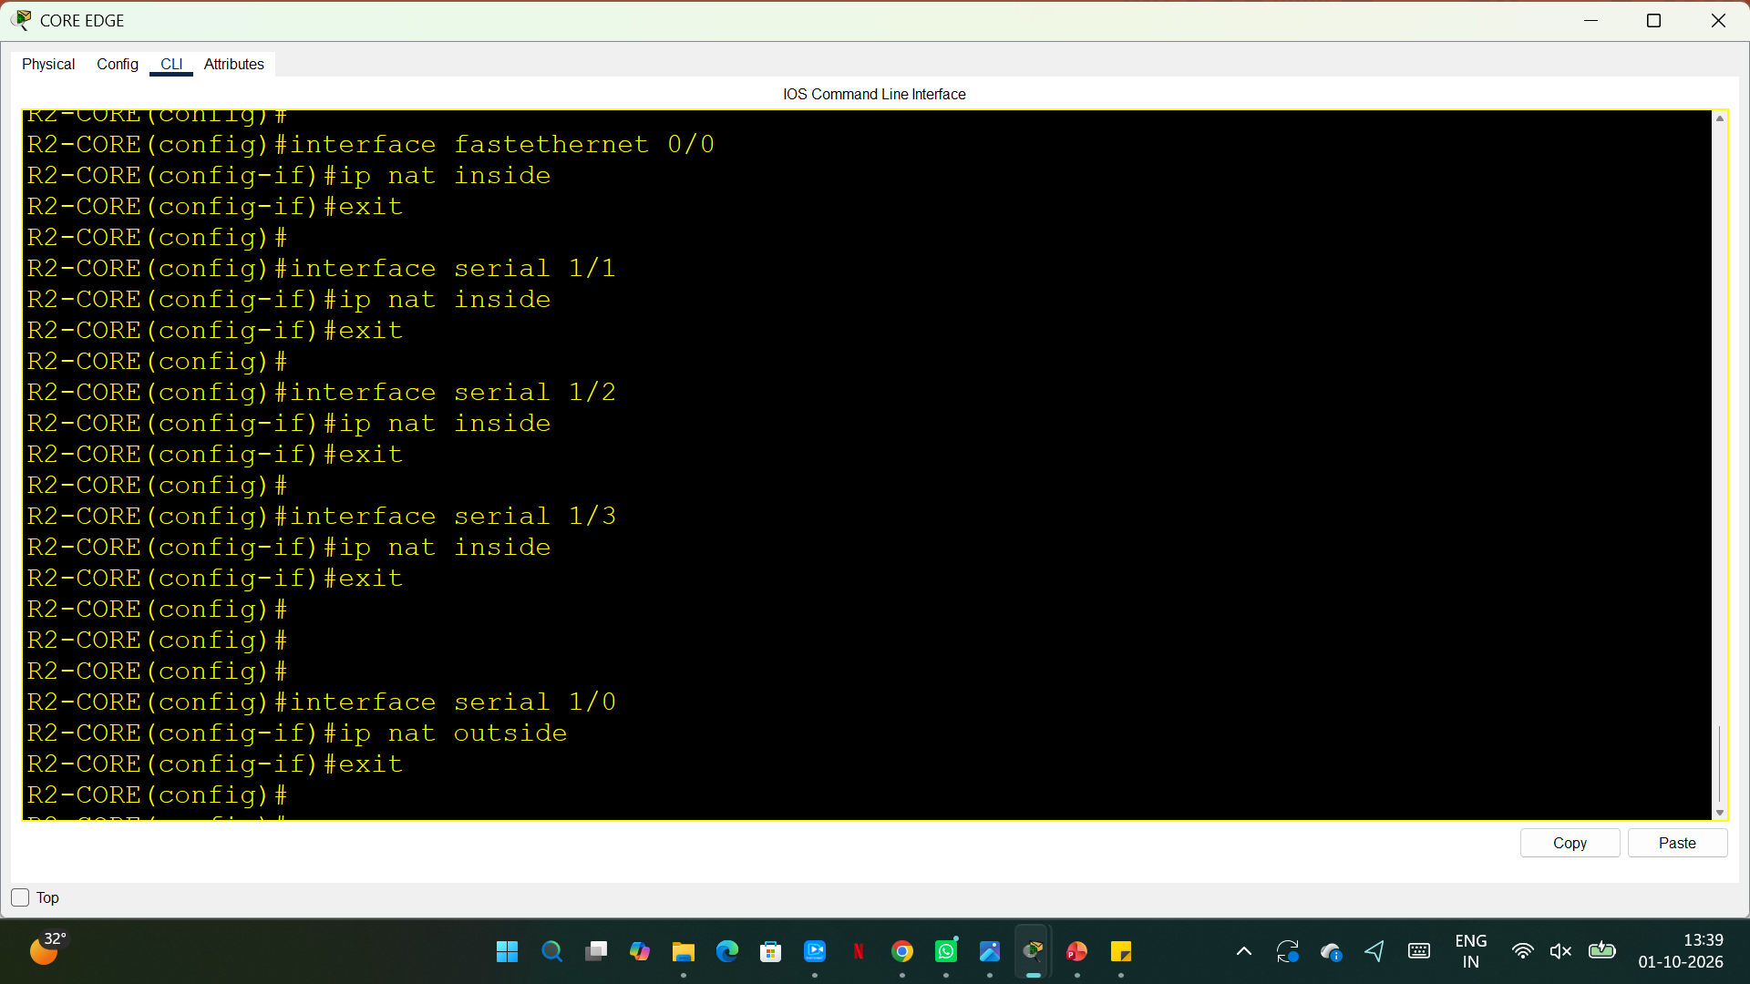
Mark internal interfaces and Mark ISP interface as outside

Slide 27
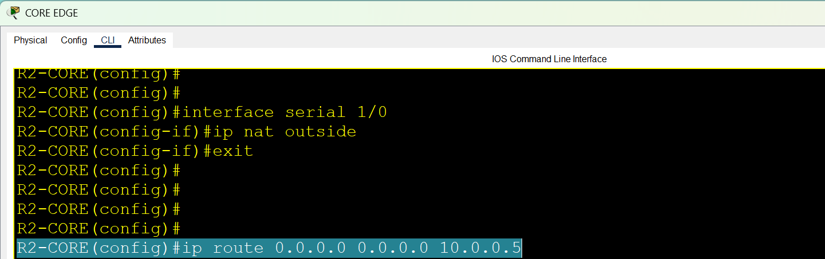
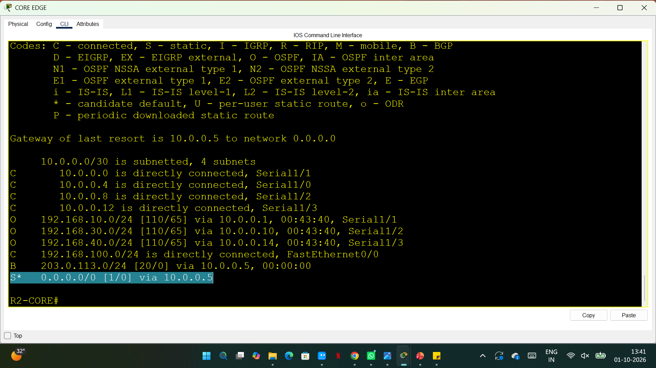
R2 needs to know that the ISP is its default path

Slide 28
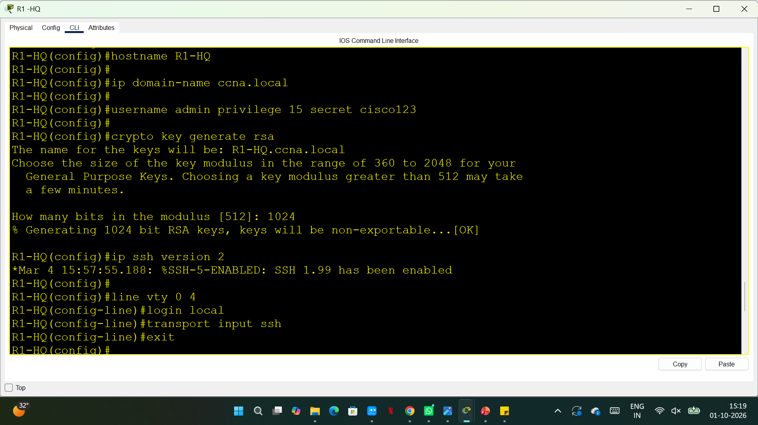
SSH ON R1

Slide 29
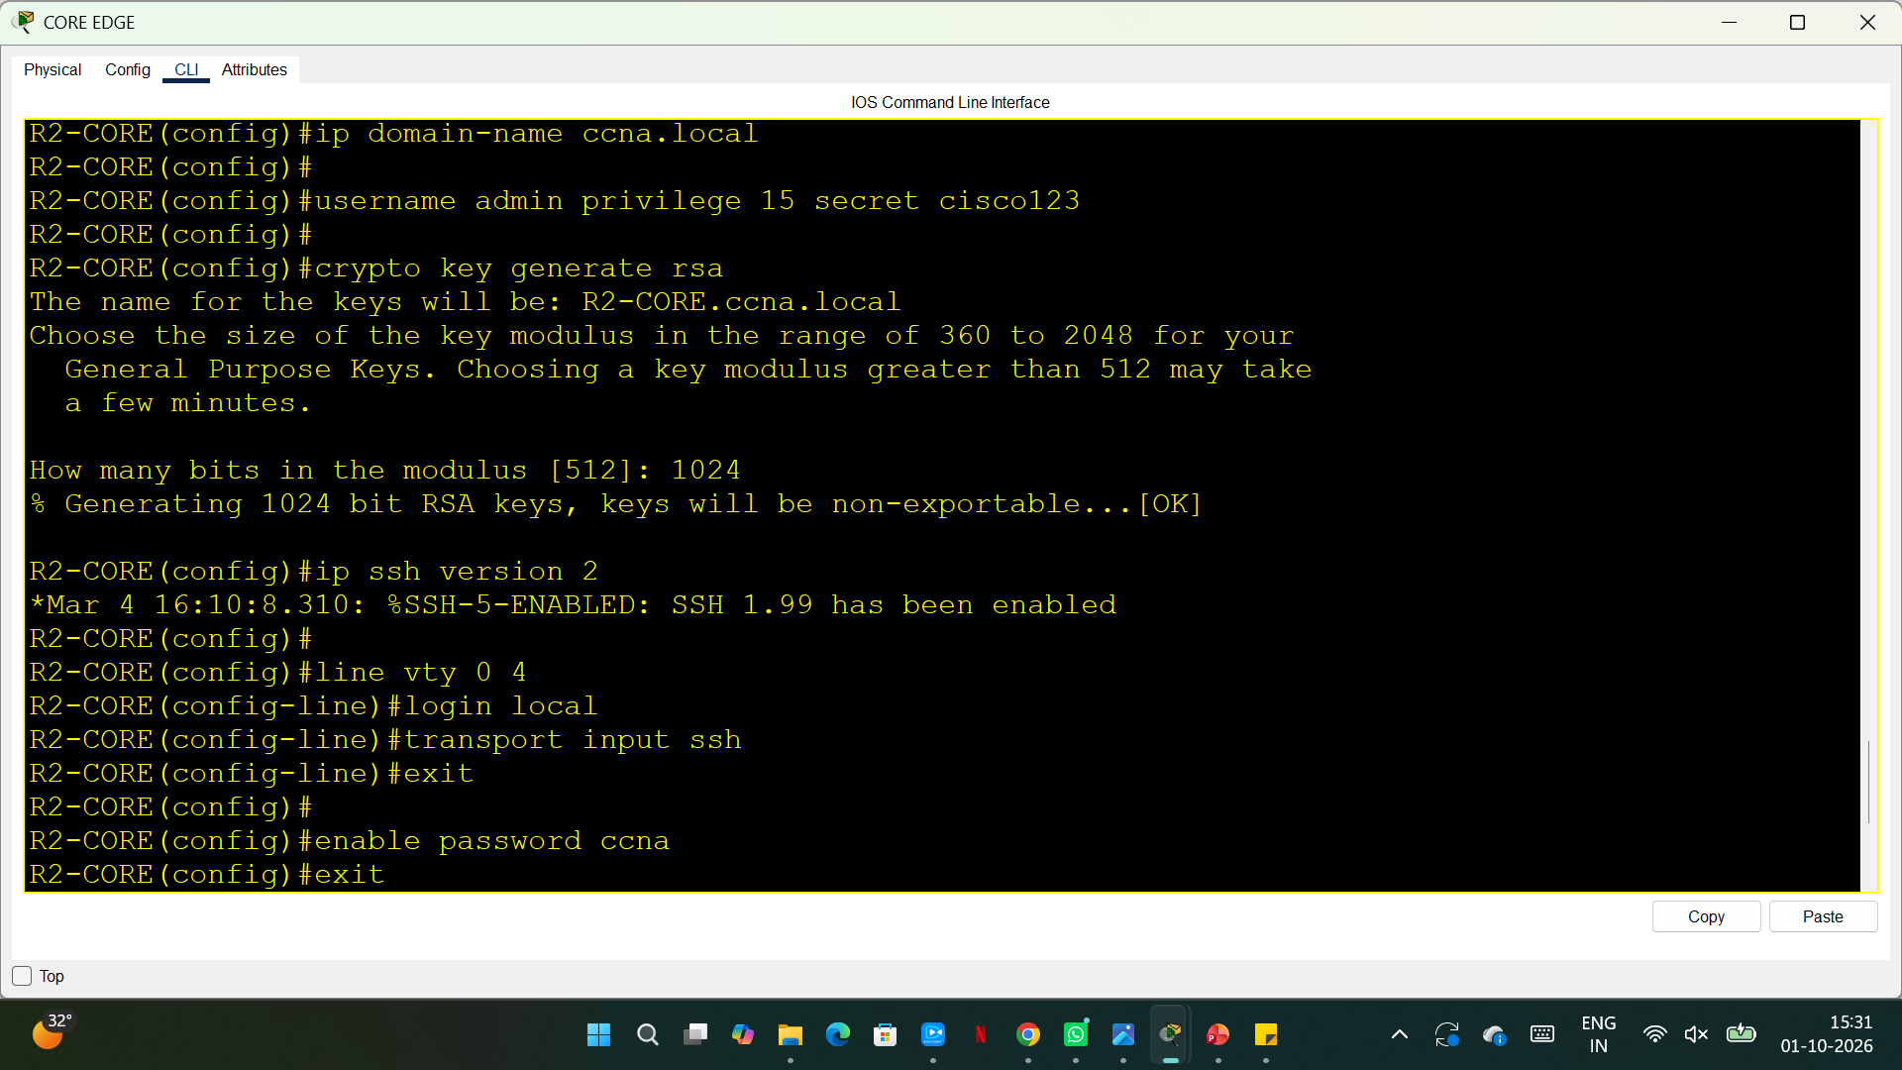
SSH ON R2

Slide 30
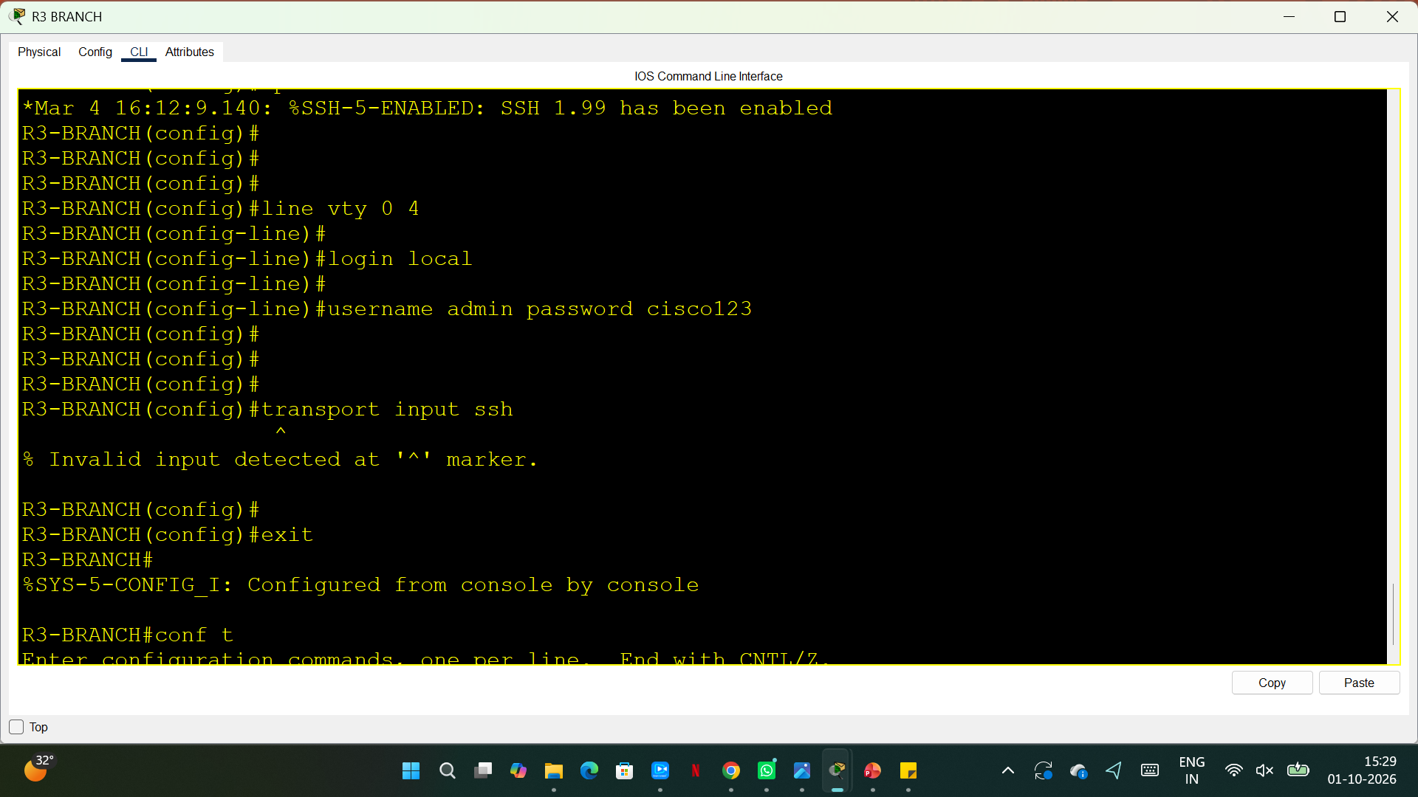
SSH ON R3

Slide 31
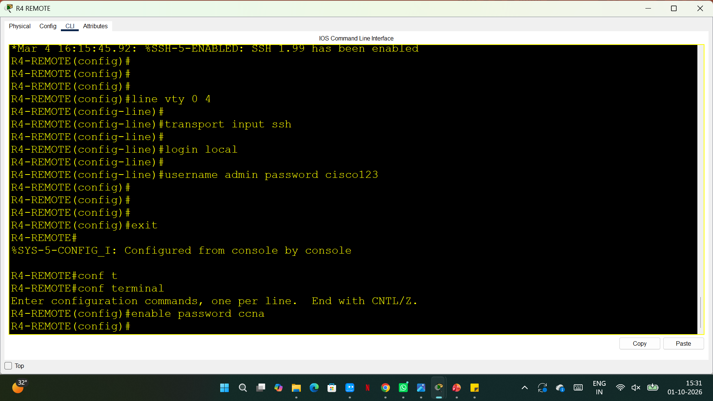
SSH ON R4

Slide 32
Challenges Faced During the Project
During the development of this project, I encountered several networking challenges.
IP Address Configuration: Assigning suitable IP addresses and subnet masks to different networks without address conflicts.
Serial Connectivity: Configuring serial interfaces between routers and ensuring that the connections were active.
Routing Protocol Configuration: Understanding and configuring routing protocols such as OSPF, RIP, and BGP.
DHCP and DNS Configuration: Ensuring that devices received IP addresses automatically and could resolve domain names correctly.
NAT Configuration: Identifying inside and outside interfaces and configuring address translation correctly.
Network Troubleshooting: Identifying connectivity problems and understanding why devices could not communicate with each other.
SSH Configuration: Setting up secure remote access and resolving authentication or key-generation issues.

